Slide 1
Security Engineering CSE 3SE/CSE 5SE Instructor: Sambuddho Chakravarty
(Semester: Winter 2016)
Week 8: March 15 – March 18

Slide 2
Brief History of Cryptography
Ancient:
Romans
Ceaser Cipher / Substitution Cipher
“Shift” characters.
E.g.
PLAINTEXT: ABCDEFGHIJKLMNOPQRSTUVWXYZ
CIPHERTEXT: XYZABCDEFGHIJKLMNOPQRSTUVW
PLAINTEXT: THE QUICK BROWN FOX JUMPS OVER THE LAZY DOG
CIPHERTEXT: QEB NRFZH YOLTK CLU GRJMP LSBO QEB IXWV ALD
Encryption: E_{n} = (x+n) mod 26
Encryption: D_{n} = (x-n) mod 26

Slide 3
Brief History of Cryptography
Attacking Ceaser Cipher:
Simple brute force attacks -- only 26 alphabets in English language.
Frequency analysis -- E.g. alphabets ‘E’ (or ‘e’) and ‘T’ (or ‘t’) are the most frequent alphabet in English language.
Encryption of ‘E’ is always the same…

Slide 4
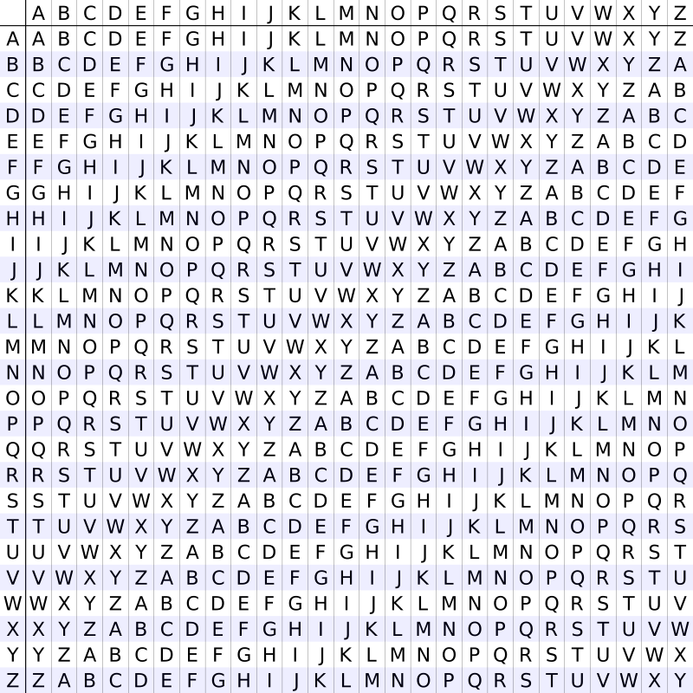
Brief History of Cryptography
Medieval Age:
Vigenere Cipher (Polyalphabetic substitution).
Inventor: Giovan Battista Bellaso in his 1553 book La cifra del Sig. Giovan Battista Bellaso (misattributed to Vigenere).
PLAINTEXT : ATTACKATDAWN
KEY : LEMON
PLAINTEXT : ATTACKATDAWN
KEY : LEMONLEMONL
CIPHER : LXFOPVEFRNHR
KEY : LEMONLEMONL
CIPHER : LXFOPVEFRNHR
PLAINTEXT : ATTACKATDAWN

Slide 5
Brief History of Cryptography
Attacks against Vignere Cipher:
Harder to break compared to simple Ceaser substitution.
Each ‘block’ is ‘effectively’ a Ceaser substitution.
Attack strategy:
Assume the key length is known.
Assume a cipher stream: nifon aicum niswt
First character ‘n’, ‘a’ and ‘n’ have been encrypted with same key alphabet.
Second character is encrypted with the same row and so on…
Perform frequency analysis for each of the first characters. The most frequently occurring character is ‘e’, the second most frequently occurring is ‘a’ and so on…
Perform similar frequency analysis for the other characters as well.

Slide 6
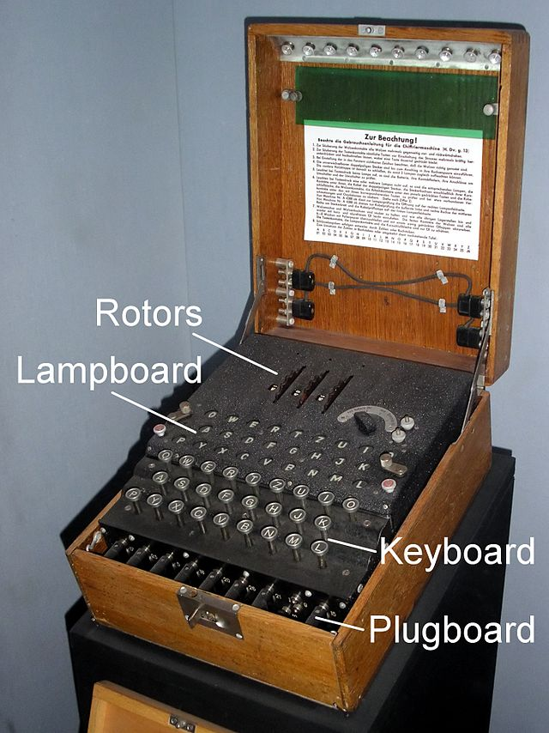
Brief History of Cryptography
Modern Era (20th Century):
Electro-mechanical rotor machines to perform multiple substitution cipher.
(Enigma Machine, Image Courtsey: National Cryptographical Museum, NSA, Washington DC)
Input: Manual keyboard
Rotor discs: Substitution ciphers
Output: Cipher-stream / telegraphic codes / Lampboards
Plugboard: Additional layer of substitution cipher

Slide 7
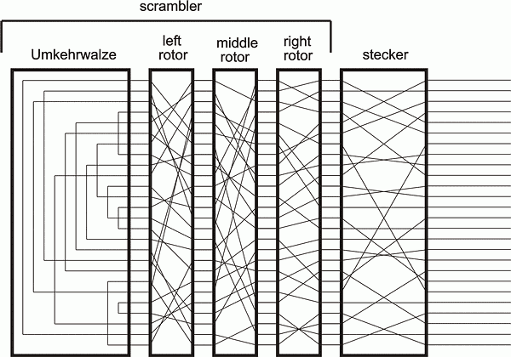
Brief History of Cryptography
Inside the Enigma Machine
Input
Output
(via
Glowlamps)

Slide 8
Some Attack Strategies
Known-plaintext attack: The adversary knows plaintext/ciphertext pairs.
Chosen-plaintext attack: Adversary chooses plaintexts and observes corresponding plaintexts to which they encrypt.
Chosen-ciphertext attack: Adversary chooses ciphertexts and sees the corresponding plaintexts to which they decrypt.

Slide 9

Vernam Cipher (One Time Pads)
Vernam Cipher (One Time Pads (OTPs)) (1917):
Each bit of the plain text is XOR-ed with each bit of the key stream
Security lies in length and pseudo-randomness of the key stream
Most basic operation: Message XOR key
Best use case: Use each key ONLY once (ONE TIME…) (considered cryptographically secure…(Shannon – “Perfect Secrecy”)).
Pr (E(M₁, K₁)) = Pr (E(M₂, K₂)) (for every K_{i} in K (key space)).
(Cipher text should not reveal the corresponding Message)
PLAINTEXT : H(7) E(4) L(11) L(11) O(14)
KEY : X(23) M(12) C(2) K(10) L(11) + (mod 26)
CIPHER : E(4) Q(16) N(13) V(21) Z(25)
M₁ XOR K₁ → C₁
M₂ XOR K₂ → C₂

Slide 10
Stream Ciphers
OTP → Stream Ciphers
Each key must be used exactly one.
Multiple usage of same key → statistical cryptanalysis attack
Reusable keying material
Generate new keys without revealing how they are generated.
The encrypted cipher text should not reveal any information about the key or the plaintext.
Each bit of the message is XOR-ed with the bit of the key.
Problem with Shannon’s “Perfect Secrecy”: Key len ≥ Message Len
Solution: PRG instead of perfectly random function.
PRG: G:{0,1}^{s}→{0,1}^{n} n >> s
E = G(k) M = C
D =G(k) C = M
Important property of PRG:
Unpredictability: Knowing some bits
of the key one should not be able to predict
the remaining bits.
k
Initial seed
G(k)
Expanded by PRG fn.
M
C

Slide 11
Some Vulnerabilities of Stream Ciphers
Multiple time usage of OTP is insecure.
C₁ = M₁ k
C₂ = M₂ k
C₁ C₂ = M₁ M₂
Easy to recover ASCII messages M₁, M₂ from M₁ M₂

Slide 12


Some Vulnerabilities of Stream Ciphers
Windows Point-to-Point Tunnelling Protocol (MS-PPTP)
(M₁ || M₂ || M₃) K
(S₁ || S₂ || S₃) K
Client and server used the same key.
Client and server messages could be XOR-ed to reveal
an XOR or the client and server messages.
Other possible attacks – cipher text only attack: The adversary
forces the client to generate messages based for specific messages and
build and oracle.
Better approach : use different keys

Slide 13
Some Vulnerabilities of Stream Ciphers
Malleability:
- Adversary can modify the ciphertext without knowing anything about the plaintext and result in equivalent changes to the corresponding plaintext.
PLAINTEXT: 0 1 0 1 (5)
KEY : 1 1 0 0
CIPHER : 1 0 0 1
DESIRED PLAINTEXT: 0 1 1 0 (6)
TODO: ((6) – (5) ) mod 2 (1 0 0 1)
0 0 1 1 1 0 0 1 = 1 0 1 0
1 0 1 0 1 1 0 0 = 0 1 1 0 (6)
- Weak key space attack : Attack on WEP

Slide 14
Some Popular Examples of Stream-Ciphers
RC4:
Date of creation: 1987
Key length: 8-bits (seeds) – 2048-bits (generator)
Randomization: None, if IV used then key must be mixed.
Remarks: HTTPS, WEP (broken)
Attack: Known-plain text attack.
A5/1, A5/2:
Date of creation: 1989
Key length: 54-bits (2G)
Randomization: 114-bits
Remarks: Voice encryption for GSM networks.
Attack: Known-plain text attack.
Salsa:
Date of creation: 2004
Key length: 256-bits; cipher stream length: 512-bits.
Randomization: 64-bit nonce.
Remarks: Optimized for hardware implementations
Attack: Aumasson, Fischer, Khazaei, Meier, and Rechberger, 2008. – probabilistic neutral bits attack.

Slide 15
Block Ciphers
Message (M) divided into multiple blocks
M₁
M₂
M₃
M₄
M_{n-1}
M_{n}
C₁
C₂
C₃
C₄
E
E
E
E
K
K
K
K
K
K₁
K₂
K₃
K_{n}
n-bits
M
C
Input: n-bits Output: n-bits
Key: ≥ n-bits
f₁(K₁ , •)
f₂(K₂ , •)
f₁(K₁ , •)
f_{n}(K_{n} , •)
m₁
m₂
m_{n}

Slide 16
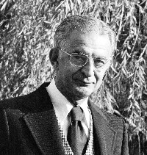
Brief History of Block Ciphers
Early 1970s: Horst-Feistel proposed Lucifer block
cipher.
Block size : 128-bits, Key: 128-bits
1973: NBS (now NIST) asked for block cipher
proposals.
IBM submits Lucifer.
1976: NBS adopts Lucifer with shorter key length and it is called
Data Encryption Standards (DES).
- Block size: 64-bits key-len: 56-bits
1997: DES broken by exhaustive search (brute force search).
2000: NIST adopts Rijndael as AES and replaces DES.

Slide 17
DES: core idea – Feistel Network
Given functions f₁, …, f_{d}: {0,1}^{n} ⟶ {0,1}^{n}
Goal: build invertible function F: {0,1}^{2n} ⟶ {0,1}^{2n}
R₀
R₁
R₂
R_{d-1}
R_{d}
n-bits
f₁
f₂
⋯
f_{d}
L₀
L₁
L₂
L_{d-1}
L_{d}
n-bits
⊕
⊕
⊕
input
output
In symbols: R_{i} = F_{i}(R_{i-1}) L_{i}
L_{i} = R_{i-1}
⊕
Slides Courtesy:
Dan Boneh

Slide 18
Decryption circuit
R_{d}
⊕
⊕
⊕
n-bits
R_{d-1}
R_{d-2}
R₁
R₀
⋯
f_{d}
f_{d-1}
f₁
L_{d}
L_{d-1}
L_{d-2}
L₁
L₀
n-bits
Inversion is basically the same circuit, with f₁, …, f_{d} applied in reverse order
General method for building invertible functions (block ciphers) from arbitrary functions.
Used in many block ciphers … but not AES
Slides Courtesy:
Dan Boneh

Slide 19
DES: 16 round Feistel network
f₁, …, f₁₆: {0,1}³² ⟶ {0,1}³² , f_{i}(x) = F( k_{i}, x )
(Round key derived
from key K)
56-bit key expanded
into 16 48-bit round keys
k
key expansion
⋯
k₁
k₂
k₁₆
16 round Feistel network
IP
IP⁻¹
64 bits
64 bits
input
output
Slides Courtesy:
Dan Boneh
To invert, use keys in reverse order

Slide 20
DES challenge
msg = “ The unkn own mess ages is: XXXX … “
CT = c₁ c₂ c₃ c₄
Goal: find k ∈ {0,1}⁵⁶ s.t. DES(k, m_{i}) = c_{i} for i=1,2,3
1997: Internet search -- 3 months
1998: EFF machine (deep crack) -- 3 days (250K $)
1999: combined search -- 22 hours
2006: COPACOBANA (120 FPGAs) -- 7 days (10K $)
⇒ 56-bit ciphers should not be used !! (128-bit key ⇒ 2⁷² days)
Slides Courtesy:
Dan Boneh

Slide 21
AES: Advanced Encryption Standard Subs-Perm network (not Feistel)
k₁
k_{n}
k₂
S₁
S₁
S₁
S₂
S₂
S₂
S₃
S₃
S₃
⋯
⨁
input
⨁
output
⨁
⋯
⋯
⋯
S₈
S₈
S₈
subs.
layer
perm.
layer
inversion
Slides Courtesy:
Dan Boneh

Slide 22
AES-128 schematic
10 rounds
4
ByteSub
ShiftRow
MixColumn
ByteSub
ShiftRow
MixColumn
ByteSub
ShiftRow
input
⋯
4
⨁
⨁
⨁
⨁
invertible
k₀
k₁
k₂
k₉
⨁
k₁₀
key
output
4
key expansion:
16 bytes
16 bytes ⟶176 bytes
4
Slides Courtesy:
Dan Boneh

Slide 23
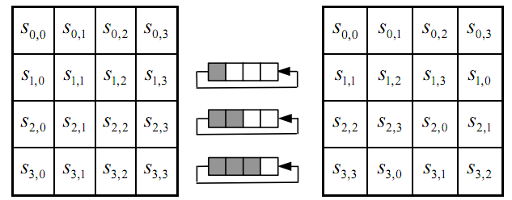
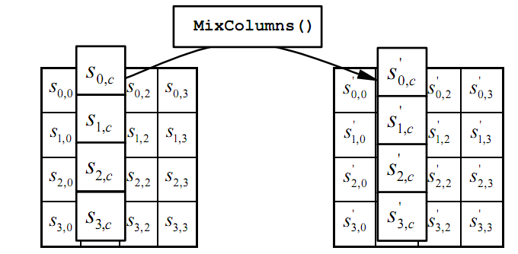
The round function
ByteSub: a 1 byte S-box. 256 byte table (easily computable)
ShiftRows:
MixColumns:
Slides Courtesy:
Dan Boneh
Notes:
S-box is easily computable with little code. All three steps can be combined and accelerated with pre-computed tables.

Slide 24
Code size/performance tradeoff
 | Code size | Performance
Pre-compute round functions (24KB or 4KB) | largest | fastest: table lookups and xors
Pre-compute S-box only (256 bytes) | smaller | slower
No pre-computation | smallest | slowest
Slides Courtesy:
Dan Boneh

Slide 25
AES in hardware
AES instructions in Intel Westmere:
aesenc, aesenclast: do one round of AES
128-bit registers: xmm1=state, xmm2=round key
aesenc xmm1, xmm2 ; puts result in xmm1
aeskeygenassist: performs AES key expansion
Claim 14 x speed-up over OpenSSL on same hardware
Similar instructions on AMD Bulldozer
Slides Courtesy:
Dan Boneh
Notes:
To implement AES called aesenc 9 times and then call aesenclast.

Slide 26
Semantic Security for many-time key
Key used more than once ⇒ adv. sees many CTs with same key
Adversary’s power: chosen-plaintext attack (CPA)
Can obtain the encryption of arbitrary messages of his choice
(conservative modeling of real life)
Adversary’s goal: Break sematic security
Slides Courtesy:
Dan Boneh

Slide 27
Solution 1: randomized encryption
E(k,m) is a randomized algorithm:
⇒ encrypting same msg twice gives different ciphertexts (w.h.p)
⇒ ciphertext must be longer than plaintext
Roughly speaking: CT-size = PT-size + “# random bits”
enc
dec
m₀
m₀
m₁
m₁
Slides Courtesy:
Dan Boneh
Notes:
Draw picture where two messages map to two disjoint ciphertext clouds. Each cloud maps to original message.
Encrypting same message twice results in different ciphertexts.

Slide 28

Solution 2: nonce-based Encryption
nonce
Alice
Bob
m, n
E
E(k,m,n)=c
c, n
D
D(k,c,n)=m
k
k
nonce n: a value that changes from msg to msg.
(k,n) pair never used more than once
method 1: nonce is a counter (e.g. packet counter)
used when encryptor keeps state from msg to msg
if decryptor has same state, need not send nonce with CT
method 2: encryptor chooses a random nonce, n ← N
Slides Courtesy:
Dan Boneh
Notes:
File encryption: random nonce, no state from file to file
SSL encrytpion (in order delivery): counter is fine, no need to send nonce to peer.
IP sec (out of order delivery): counter is fine, but need to include nonce in every packet.

Slide 29
Construction 1: CBC with random IV
E_{CBC}(k,m): choose random IV:
IV
m[0]
m[1]
m[2]
m[3]
⊕
⊕
⊕
⊕
E(k,⋅)
E(k,⋅)
E(k,⋅)
E(k,⋅)
IV
c[0]
c[1]
c[2]
c[3]
ciphertext
Slides Courtesy:
Dan Boneh
Notes:
Unlike ECB, same block in different positions gets mapped to different ciphertexts.

Slide 30
Decryption circuit
In symbols: c[0] = E(k, IV⨁m[0] ) ⇒ m[0] = D(k, c[0]) ⨁ IV
IV
c[0]
c[1]
c[2]
c[3]
D(k,⋅)
D(k,⋅)
D(k,⋅)
D(k,⋅)
⊕
⊕
⊕
⊕
m[0]
m[1]
m[2]
m[3]
Slides Courtesy:
Dan Boneh

Slide 31
Nonce-based CBC
Cipher block chaining with unique nonce: key = (k,k₁)
unique nonce means: (key, n) pair is used for only one message
nonce
m[0]
m[1]
m[2]
m[3]
IV
⊕
⊕
⊕
⊕
E(k₁,⋅)
E(k,⋅)
E(k,⋅)
E(k,⋅)
E(k,⋅)
nonce
c[0]
c[1]
c[2]
c[3]
ciphertext
included only if unknown to decryptor
Notes:
Unique means non-random, but unique. Note that setting IV = E(k,nonce) is insecure.

Slide 32
Construction 2: rand ctr-mode
E(k,m): choose a random IV ∈ {0,1}^{n} and do:
msg
IV
m[0]
m[1]
…
m[L]
⊕
F(k,IV)
F(k,IV+1)
…
F(k,IV+L)
IV
c[0]
c[1]
…
c[L]
ciphertext
note: parallelizable (unlike CBC)
Slides Courtesy:
Dan Boneh

Slide 33
Construction 2’: nonce ctr-mode
msg
IV
m[0]
m[1]
…
m[L]
⊕
F(k,IV)
F(k,IV+1)
…
F(k,IV+L)
IV
c[0]
c[1]
…
c[L]
ciphertext
To ensure F(k,x) is never used more than once, choose IV as:
128 bits
IV:
nonce
counter
starts at 0 for every msg
Slides Courtesy:
Dan Boneh
64 bits
64 bits
Notes:
Max message length is 2^64 blocks.

Slide 34
Message Integrity
Goal: integrity, no confidentiality.
Examples:
Protecting public binaries on disk.
Protecting banner ads on web pages.
Slides Courtesy:
Dan Boneh

Slide 35
Message integrity: MACs
k
k
message m
tag
Alice
Bob
Generate tag:
tag ← S(k, m)
Verify tag:
V(k, m, tag) = `yes’
?
Def: MAC I = (S,V) defined over (K,M,T) is a pair of algs:
S(k,m) outputs t in T
V(k,m,t) outputs `yes’ or `no’
Slides Courtesy:
Dan Boneh

Slide 36
Integrity requires a secret key
message m
tag
Alice
Bob
Generate tag:
tag ← CRC(m)
Verify tag:
V(m, tag) = `yes’
?
Attacker can easily modify message m and re-compute CRC.
CRC designed to detect random, not malicious errors.
Slides Courtesy:
Dan Boneh

Slide 37
Example: protecting system files
Suppose at install time the system computes:
filename
filename
filename
F₁
F₂
F_{n}
⋯
k derived from user’s password
t₁ = S(k,F₁)
t₂ = S(k,F₂)
t_{n} = S(k,F_{n})
Later a virus infects system and modifies system files
User reboots into clean OS and supplies his password
Then: secure MAC ⇒ all modified files will be detected
Slides Courtesy:
Dan Boneh
Notes:
Virus cannot create (F’, t’) that will verify properly. Note however that virus may try to swap files around.

Slide 38
Attacks Against MACs
Existential Forgery: The attacker produces a signature s of some message m of his choice.
Selective Forgery: The attacker chooses a message m, then gets access to the public key used for verification, and produces a signature s of m.
Key recovery: Given the public key for verification, the attacker produces the secret key for signing.
Slides Courtesy:
Dan Boneh

Slide 39
The Merkle-Damgard Iterated Construction
m[0]
m[1]
m[2]
m[3] ll PB
IV
(fixed)
h
h
h
h
H(m)
H₀
H₁
H₂
H₃
H₄
PB: padding block
1000…0 ll msg len
If no space for PB add another block
Slides Courtesy:
Dan Boneh
64 bits

Slide 40
MAC Using Merkel Damgard Contruction
m[0]
m[1]
m[2]
m[3] ll PB
w
Add extra block ‘w’.
From H(k||m) you can derive H(k||m||PB||w)`
H(m)
IV
(fixed)
h
h
h
h
h
H₀
H₁
H₂
H₃
H₄
H₅
Slides Courtesy:
Dan Boneh

Slide 41
Standardized method: HMAC (Hash-MAC)
Most widely used MAC on the Internet.
Use for calculating a message authentication code (MAC) involving a cryptographic hash function that may use a secret cryptographic key.
H: hash function.
example: SHA-256 ; output is 256 bits
Building a MAC out of a hash function:
HMAC: S( k, m ) = H( k⊕opad , H( k⊕ipad ll m ) )
Slides Courtesy:
Dan Boneh

Slide 42
HMAC
k⨁ipad
m[0]
m[1]
m[2] ll PB
IV
(fixed)
>
h
h
h
h
>
>
>
k1
k⨁opad
>
h
tag
h
k2
>
IV
(fixed)
Notes:
Draw arrows to show k1 and k2.

Slide 43
Miscellaneous – Material not covered in Winter 2016

Slide 44
Encrypted CBC-MAC (ECBC-MAC)s
raw CBC
m[0]
m[1]
m[3]
m[4]
⊕
⊕
⊕
F(k,⋅)
F(k,⋅)
F(k,⋅)
F(k,⋅)
F(k₁,⋅)
tag
Slides Courtesy:
Dan Boneh
Notes:
Define the notation X^{<L}

Slide 45
NMAC (nested MAC)
cascade
m[0]
m[1]
m[3]
m[4]
k
t
F
F
F
F
t ll fpad
>
>
>
>
F
>
k₁
tag
Slides Courtesy:
Dan Boneh
Notes:
Explain that both MACs use a final encryption step. The internal PRFs are only secure for prefix free messages --- simply say fixed length messages.
Cascade is a generalization of GGM. Is the basis of HMAC.

Slide 46
NMAC (nested MAC) without last block padding + encryption
cascade
m[0]
m[1]
m[3]
m[4]
w
k
t
F
F
F
F
F
>
>
>
>
>
F
>
k₁
tag
Slides Courtesy:
Dan Boneh
Notes:
Explain that both MACs use a final encryption step. The internal PRFs are only secure for prefix free messages --- simply say fixed length messages.
Cascade is a generalization of GGM. Is the basis of HMAC.

Slide 47
Why the last encryption step in ECBC-MAC?
Adversary works as follows:
Choose an arbitrary one-block message m∈X
Request tag for m. Get t = F(k,m)
Output t as MAC forgery for the 2-block message m’ = (m, t⊕m)
rawCBC(k, (m, t⊕m) ) = F(k, F(k,m)⊕(t⊕m) ) = F(k, t⊕(t⊕m) ) = t
Slides Courtesy:
Dan Boneh
Notes:
Note that forgery is an extension of query. rawCBC is a secure PRF if no message is a prefix of another (e.g. if all messages are same length).

Slide 48
The security bounds are tight: an attack
After signing |X|^{1/2} messages with ECBC-MAC or
|K|^{1/2} messages with NMAC
the MACs become insecure
Slides Courtesy:
Dan Boneh
Notes:
Actually, don’t need to assume F is a PRP.

